Slide 1
Lesson 3.19
Admissible Claims
CGPRT(W) : Ensuring Clean Seas and Coasts in Western Region ……

Slide 2
Objective
To understand what can be claimed and compensated.
To understand the concept of reasonableness
CGPRT(W) : Ensuring Clean Seas and Coasts in Western Region ……

Slide 3
Pollution Damage
CGPRT(W) : Ensuring Clean Seas and Coasts in Western Region ……

Slide 4
Pollution Damage
Loss or damage caused outside the ship by contamination from escape or discharge from the ship wherever escape or discharge occur
Costs of preventive measures and further loss or damage caused by preventive measures
CGPRT(W) : Ensuring Clean Seas and Coasts in Western Region ……

Slide 5
Preventive Measures
any reasonable measure taken by any person after an incident to prevent or minimize pollution damage
before an incident if grave and imminent threat of pollution damage (Art I. 7 & 8, 1992 CLC)
CGPRT(W) : Ensuring Clean Seas and Coasts in Western Region ……

Slide 6
Preventive Measures: Clean-up Costs
Generally – clean-up
  Combat oil at sea
  Protect sensitive resources
  Clean shorelines and coastal installations
  Dispose collected oil and oily waste
  Prevent pollution damage through salvage operations
CGPRT(W) : Ensuring Clean Seas and Coasts in Western Region ……

Slide 7
Preventive Measures: Clean-up Costs
Compensation for
  personnel and hire/purchase of equipment and material
  additional costs (overtime)
  fixed costs of personnel from public bodies
  Loss/damage caused by clean-up operations
CGPRT(W) : Ensuring Clean Seas and Coasts in Western Region ……

Slide 8
Preventive Measures: Clean-up Costs
Admissibility criteria
  expense must actually be incurred
  response measures should be reasonable and justifiable
  expense must be due directly to the contamination
CGPRT(W) : Ensuring Clean Seas and Coasts in Western Region ……

Slide 9
Reasonable
Preventive measures should:
Be based on a technical appraisal
Take into consideration the best available information at the time
Have a possibility of being effective
CGPRT(W) : Ensuring Clean Seas and Coasts in Western Region ……

Slide 10
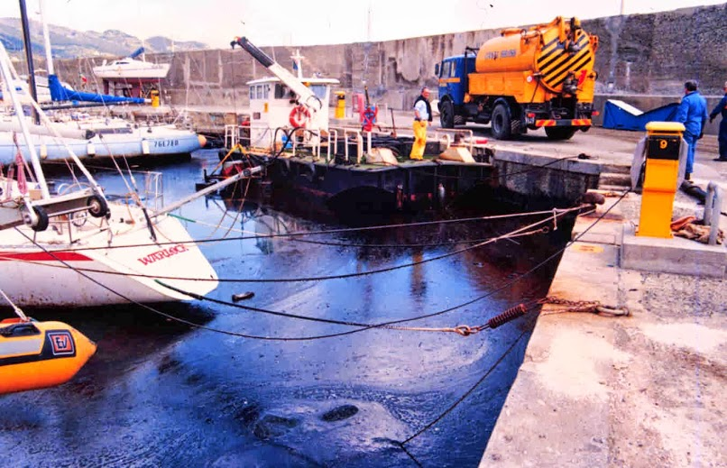
Property Damage
Damage to commercial and private vessels
Source: Cedre
CGPRT(W) : Ensuring Clean Seas and Coasts in Western Region ……

Slide 11
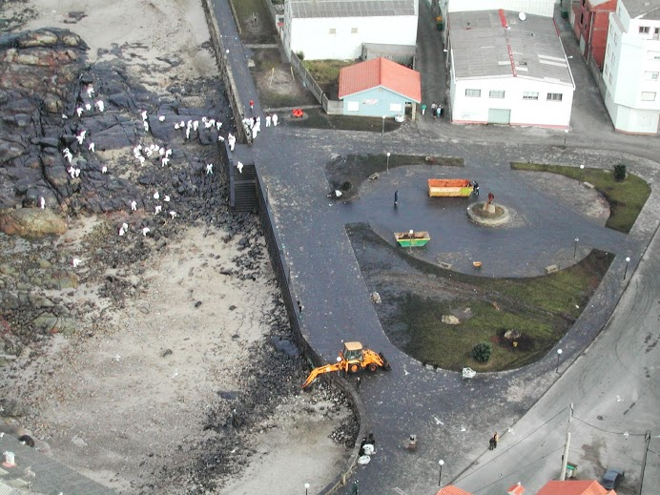
Property Damage
Damage to roads during clean-up
CGPRT(W) : Ensuring Clean Seas and Coasts in Western Region ……

Slide 12
Property Damage
Other types of property damage:
Contamination of seawater intakes
Damage to fishing gear (nets, pod, etc.)
Damage to fish farms
CGPRT(W) : Ensuring Clean Seas and Coasts in Western Region ……

Slide 13
Property Damage
Compensation for
  Costs to clean: manpower and materials
  Costs to repair or replace damaged equipment
  Minus wear and tear
CGPRT(W) : Ensuring Clean Seas and Coasts in Western Region ……

Slide 14
Property Damage
Admissibility criteria
  Measures and costs must be reasonable
  Claims based on invoices
  Estimates not acceptable
  No compensation for improvement
CGPRT(W) : Ensuring Clean Seas and Coasts in Western Region ……

Slide 15
Pollution Damage
Common problems
  Insufficient supporting documentation
  No independent verification of damage
  Not taking into account wear and tear
  Expectation of new for old – improvement
  Damage from different origin
CGPRT(W) : Ensuring Clean Seas and Coasts in Western Region ……

Slide 16
Presentation of Claims
Extent of damage
Explanation of how damage occurred
Photographs of damage and location
Cost of repairs, cleaning and/or replacement
Age of items to replace
Cost of restoration after clean-up
Assessment on evidence provided and available
Burden of proof on claimant
CGPRT(W) : Ensuring Clean Seas and Coasts in Western Region ……

Slide 17
Fisheries
CGPRT(W) : Ensuring Clean Seas and Coasts in Western Region ……

Slide 18
Fisheries
Consequential and pure economic loss
Specific criteria of admissibility
Types of claims
  Fisheries claims
  Mariculture claims
  Processing claims
Presentation of claims
Claims assessment
CGPRT(W) : Ensuring Clean Seas and Coasts in Western Region ……

Slide 19
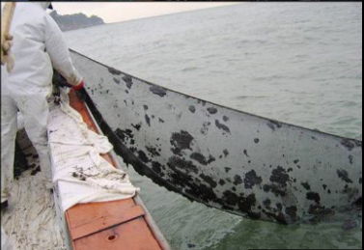
Consequential Loss
Loss of revenue by the owners or users of property contaminated as a result of a spill.
Examples:
  Fishermen unable to fish due to fishing boat or fishing gear contaminated with oil.
CGPRT(W) : Ensuring Clean Seas and Coasts in Western Region ……

Slide 20
Pure Economic Loss
• Loss of earnings sustained by persons whose property has not been polluted.
Example:
  Fishermen are unable to fish because the area of the sea where they normally fish is polluted and they cannot fish elsewhere.
CGPRT(W) : Ensuring Clean Seas and Coasts in Western Region ……

Slide 21
Admissibility Criteria
Damage or loss linked directly to the pollution
Geographic proximity between the claimant’s activity and the contamination
Claimant’s economic dependence on the affected resource
Alternative sources of supply
In the case of a marketing campaign, the claim must relate to actual targeted markets
CGPRT(W) : Ensuring Clean Seas and Coasts in Western Region ……

Slide 22
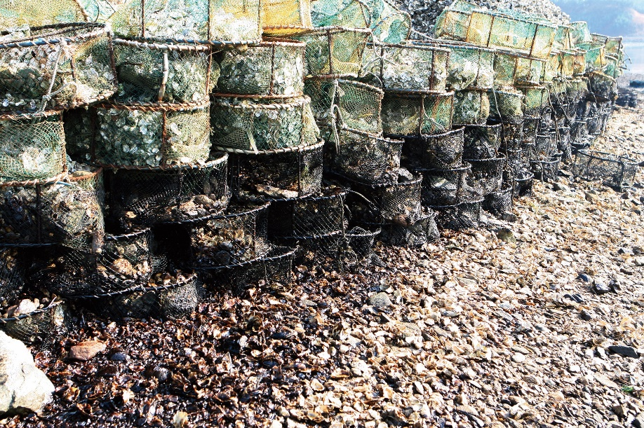
Impact of Oil on Fisheries
Contaminated fishing gear
Fishing bans
  to prevent contamination of gear and catches
  to protect human health (temporary contamination)
Loss of market confidence
CGPRT(W) : Ensuring Clean Seas and Coasts in Western Region ……

Slide 23
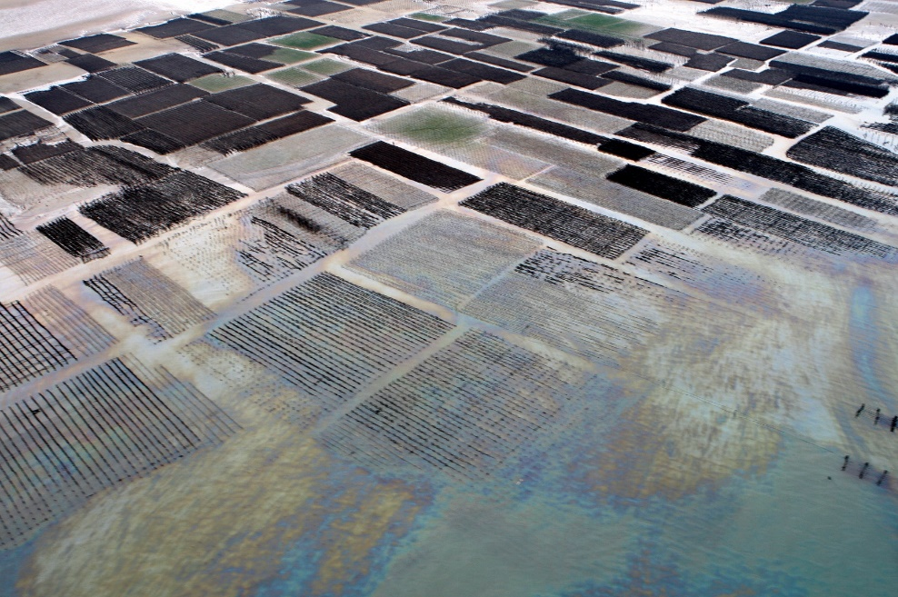
Impact of Oil on Mariculture
Contamination of onshore and offshore facilities (fish cages, shellfish rafts, onshore tanks and ponds)
Contamination of stocks (tainting, mortality)
Harvesting bans
Loss of market confidence
CGPRT(W) : Ensuring Clean Seas and Coasts in Western Region ……

Slide 24
Impact of Oil on Processing
Contamination of plant
Reduction in supply
Reduction in demand
CGPRT(W) : Ensuring Clean Seas and Coasts in Western Region ……

Slide 25
Contamination of Product
Fishing bans should be justified
Presence of oil in vicinity of fishing grounds or mariculture facilities
Contamination of stocks demonstrated by chemical analysis or taste testing
CGPRT(W) : Ensuring Clean Seas and Coasts in Western Region ……

Slide 26
Destruction of Product
Factors to be considered:
  Whether product is contaminated
  Likelihood that contamination would disappear before normal harvesting time
  Whether retention of product affects further production
  Likelihood of product being marketable at normal harvesting time
CGPRT(W) : Ensuring Clean Seas and Coasts in Western Region ……

Slide 27
Claims Presentation
Proof linking loss to contamination
Comparative earnings in previous periods and during period of loss, e.g. accounts, tax returns, sales invoices and receipts
Where possible, monthly breakdown of quantity of each marine product caught, harvested or processed for the period of the loss and previous periods
Method of assessment of the loss
Savings
CGPRT(W) : Ensuring Clean Seas and Coasts in Western Region ……

Slide 28
Subsistence fishing (artisanal)
Unlikely to have supporting documentation
Likely to be in need of urgent compensation
Interim payments in hardship cases
Sources of information:
  Government statistics
  Field surveys of similar unaffected fishing
  Interviews
CGPRT(W) : Ensuring Clean Seas and Coasts in Western Region ……

Slide 29
Tourism
CGPRT(W) : Ensuring Clean Seas and Coasts in Western Region ……

Slide 30
Tourism
Consequential and pure economic loss
Admissibility criteria
Types of business affected
Common problems
Presentation
Assessment
CGPRT(W) : Ensuring Clean Seas and Coasts in Western Region ……

Slide 31
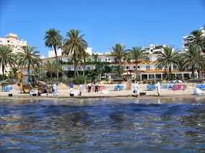
Consequential Loss
Loss of earnings suffered by the owners or users of property contaminated as a result of a spill.
Examples:
  Oiling of hotel and restaurant; property located on coast
CGPRT(W) : Ensuring Clean Seas and Coasts in Western Region ……

Slide 32
Pure Economic Loss
Loss of earnings sustained by persons whose property has not been polluted.
Example:
  Hotels or restaurants near the contaminated beach may suffer loss of profit due to reduction in guests
CGPRT(W) : Ensuring Clean Seas and Coasts in Western Region ……

Slide 33
Admissibility Criteria
Link of causation between loss or damage and the contamination, i.e. reasonable degree of proximity
Various factors to consider if there is link of causation
CGPRT(W) : Ensuring Clean Seas and Coasts in Western Region ……

Slide 34
Admissibility Criteria
Factors to consider:
  Geographic proximity between the claimant’s activity and the contamination
  Claimant’s economic dependence on the affected resource
  Extent to which the business forms an integral part of the economic activity within the area affected
  In the case of a marketing campaign, the claim must relate to actual targeted markets
CGPRT(W) : Ensuring Clean Seas and Coasts in Western Region ……

Slide 35
Types of Business Affected
Hotels
Camp sites
Restaurants
Pubs and bars
Ferry services
Tourist attractions
CGPRT(W) : Ensuring Clean Seas and Coasts in Western Region ……

Slide 36
Common Problems
Difficulty in assessing claims by documents alone
Importance of visit to business
Time lag: waiting for the end of tourist season to determine loss
CGPRT(W) : Ensuring Clean Seas and Coasts in Western Region ……

Slide 37
Presentation of Claims
General Information
  Details of incorporation, ownership, etc.
  Tax records for the previous three years
  Map and photographs of the business
Financial and accounting Information
  Annual accounts for at least three years before the incident
  Details of variable costs and profit margins for each activity of the organization.
CGPRT(W) : Ensuring Clean Seas and Coasts in Western Region ……

Slide 38
Assessment of Claims
Objective: put the claimant in the same position as if the incident had not occurred.
  Assessment based on understanding how the business works.
  Account taken of any decline or growth in the business based on previous years.
  Effect of downturn on variable costs – saved costs.
CGPRT(W) : Ensuring Clean Seas and Coasts in Western Region ……

Slide 39
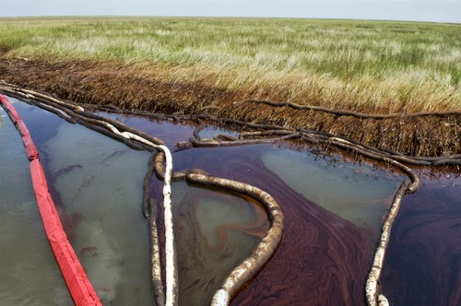
Environmental Damage
Admissible costs?
Costs of technically feasible and proportionate measures to reinstate contaminated environment, which have a reasonable chance to accelerate the natural recovery process.
Proportionate scientific studies to establish nature and extent of environmental damage and whether reinstatement is necessary and feasible.
Compensation for environmental damage based on calculations using theoretical models are not considered admissible.
CGPRT(W) : Ensuring Clean Seas and Coasts in Western Region ……

Slide 40
Conclusion
Compensation for various types of claims
Documentation is key to success
Work closely with experts appointed by vessel insurer and/or IOPC Funds
CGPRT(W) : Ensuring Clean Seas and Coasts in Western Region ……

Slide 41
Any questions?
CGPRT(W) : Ensuring Clean Seas and Coasts in Western Region ……

